Slide 1
Impact of CSR on Brand Image: A Customer’s Perspective on Hindustan Unilever Limited (HUL)

Slide 2
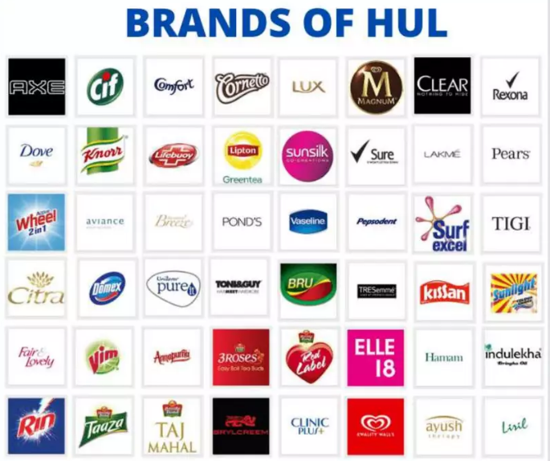
INTRODUCTION
CSR has transformed from a voluntary act to a strategic business necessity.
HUL, a Unilever subsidiary and India's leading FMCG company, integrates CSR in branding.
Notable CSR efforts include Project Shakti, hygiene campaigns, and sustainability projects.
CSR builds a trustworthy brand image and aligns business operations with ethical, environmental, and social values.

Slide 3
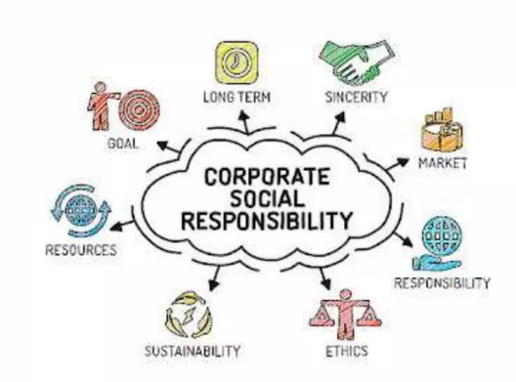
Objective & Research Questions
Research Questions
Objectives
Objectives:
Evaluate the effectiveness of HUL’s environmental and social initiatives on its brand image.
Analyze factors influencing consumer purchase decisions.
How do HUL’s CSR efforts impact its brand image?
Do CSR-focused ads and campaigns influence consumer choices?

Slide 4
Research Methodology
Sampling: Convenience sampling (students, working professionals, general public)
Tools: Likert scale, charts, bar graphs
Analysis: Regression model to assess the impact of CSR awareness on brand perception
Research Design: Descriptive
Primary Data: 68 responses via structured Google Forms survey
Secondary Data: Academic articles, reports, official documents

Slide 5
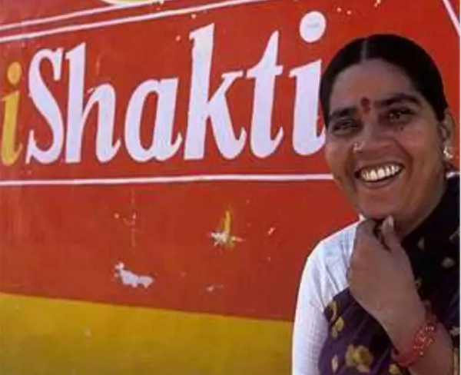
HUL’S CSR INITIATIVES
Project Shakti – Rural women entrepreneurship and micro-distribution.
Swachh Aadat, Swachh Bharat – Hygiene awareness aligned with national mission.
COVID-19 Relief – Medical support, hygiene products, PPE to hospitals and workers.
Fair & Lovely Foundation – Scholarships for meritorious girls.
Handwashing Campaigns – School programs reducing child mortality through hygiene education.

Slide 6
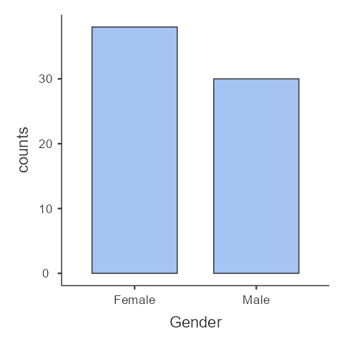
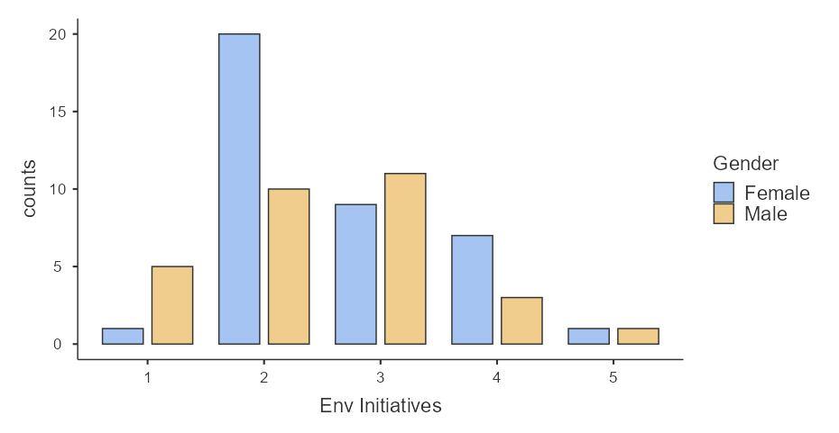
1)Gender & Age Insights
Age group 18–38 – peak brand influence zone
Majority female (55.9%), high responsive to ethical branding
2) Environmental & Social CSR Impact
Social programs also had strong influence, esp. among women
50% say environmental initiatives positively influenced brand perception
Data Analysis

Slide 7
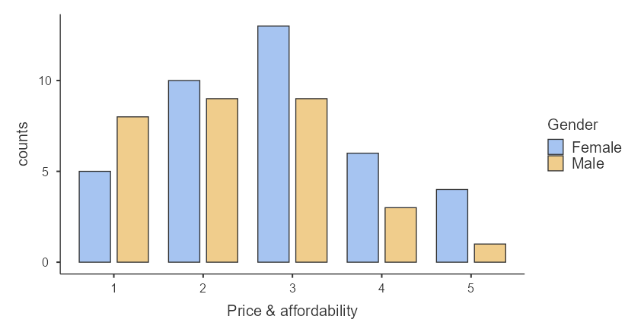
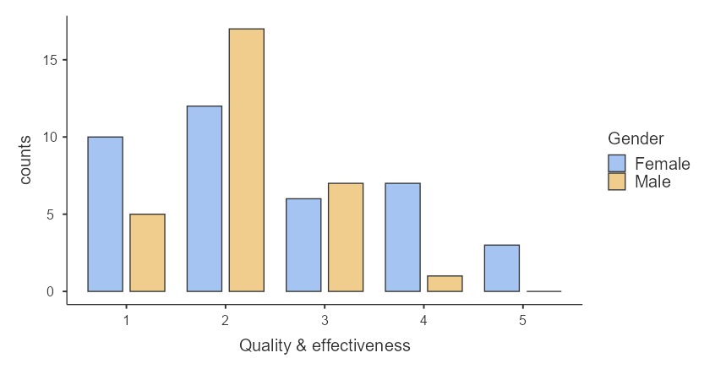
CSR improves trust, boosts HUL’s reputation
Price & Affordability influences 47%
Quality & Effectiveness: major driver (64.7%)
Brand Factors- Perception, Reputation

Slide 8
Hypothesis Testing
To test if the awareness of Environmental and Social Initiatives done as CSR have significant impact on the brand image of HUL products.
H₀ (Null Hypothesis): Awareness of Environmental and Social Initiatives done as CSR have no significant impact on the brand image of HUL products.
H₁ (Alternate Hypothesis): Awareness of Environmental and Social Initiatives done as CSR does have a significant impact on the brand image of HUL products.
To test the Hypothesis made we will be using Regression considering Brand Image as an Independent Variable, Environmental and Social Initiatives as dependent variables.

Slide 9
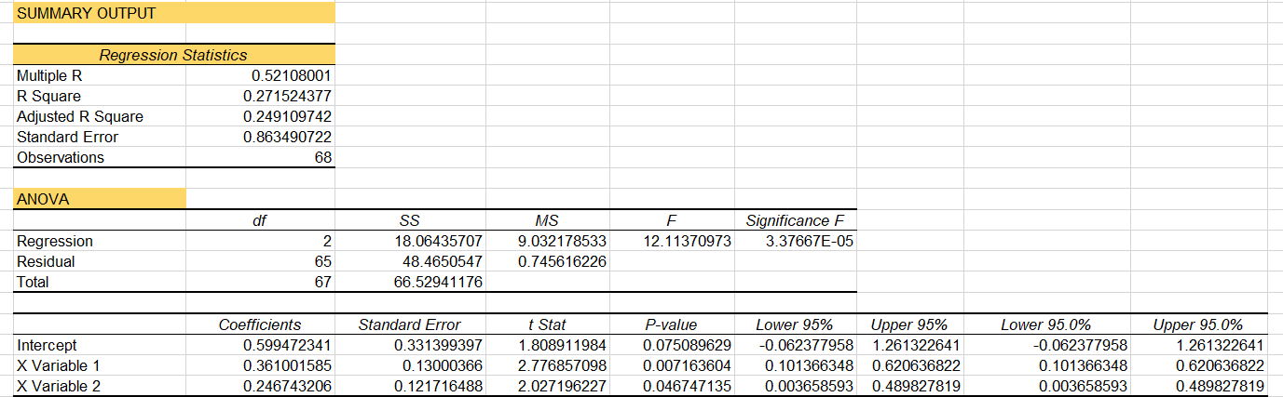
Interpretation
Both CSR components (Environmental + Social) have statistically significant positive coefficients, meaning:
As awareness increases, brand image scores go up.
Since their p-values < 0.05, we reject the null hypothesis (H₀) for individual predictors too.
Hence, we Reject the null hypothesis CSR Awareness (both environmental & social) does significantly influence brand image of HUL products.

Slide 10
Key Findings & Conclusion
Key Findings:
CSR significantly impacts customer perception
Younger and female consumers more responsive
Environmental & Social Initiatives have significant impact on brand image.
Conclusion:
HUL’s CSR = brand equity booster
Transparency & communication = essential to sustain impact
CSR should be embedded in long-term strategy

Slide 11

Thank you!
Presented By: Sneha Panwar, Puja Das, Manish Kumar & Pranav Kadyan

